Slide 1
Comparison of Node Backend Frameworks
Xintong Ma

Slide 2
Node.js frameworks built on Express:
Feathers: Build prototypes in minutes and production ready real-time apps in days.
ItemsAPI: Search backend for web and mobile applications built on Express and Elastic search.
KeystoneJS: Website and API Application Framework / CMS with an auto-generated React.js Admin UI.
Kraken: Secure and scalable layer that extends Express by providing structure and convention.
LEAN-STACK: The Pure JavaScript Stack.
LoopBack: Highly-extensible, open-source Node.js framework for quickly creating dynamic end-to-end REST APIs.
Sails: MVC framework for Node.js for building practical, production-ready apps.
Blueprint: Highly-configurable MVC framework for composing production-ready services from reusable components.

Slide 3
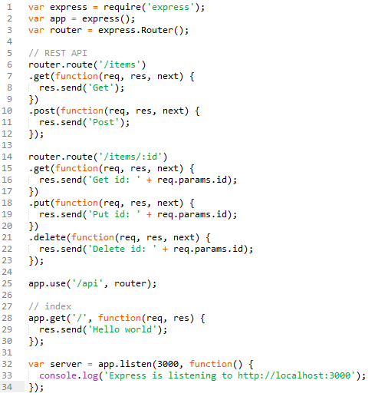
Get
/items
Post
/api
Get
/items/:id
Delete
localhost
Put
/
Get
App.use()
Router.route()
express.Router()
Mounts the middleware function to path
Avoid duplicate route names and typo errors
Creates a new router object

Slide 4
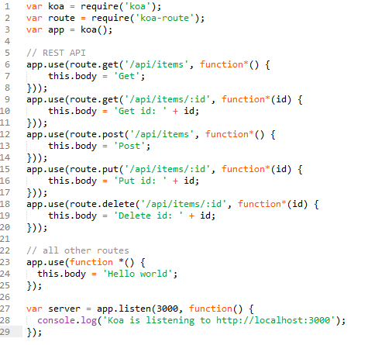
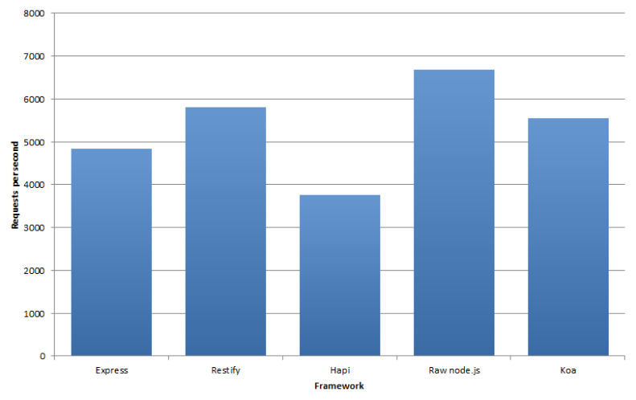
requires a separate middleware to handle routes
doesn't have the ability to reduce the repetitive route verbs like Express

Slide 5
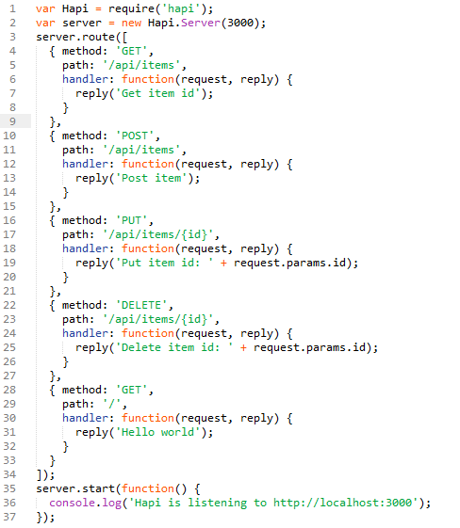
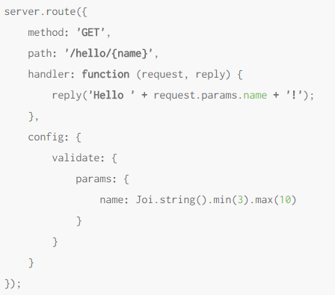
Hapi includes some of the following features built-in that Express and Koa does not :
Input and response validation(through Joi)
Cookie-parsing
Sessions
CORS support
Logging
clean and readable code for every endpoint

Slide 6
We have seen some good but practical examples of all three frameworks. Express is definitely the most popular and most recognized framework of the three. It is almost a reaction to first create a server using Express when starting new development on an application but hopefully now there might be some thought involved whether to use Koa or Hapi as an alternative. Koa shows real promise for the future and it is the fastest framework . Hapi has a lot of nice plugin features.

Slide 7
Reference
https://expressjs.com
http://hapijs.com

